Slide 1


Introduction to
&
Mark Elliott
May 2024

Slide 2
What will we cover during this Introduction Course?
What is R
Setting up R and RStudio - installation, themes etc.
R Document types
Working directory
Writing and executing Code - the Basics
What is base R
Packages
Outputs
Saving Documents
Hosting Documents - Sharing Code
Loading Data - Sources of data 1
Manipulating Data
Visuals

Slide 3
Introduction - What is R
R is an open source language and environment, primarily for statistical computing and graphics
R is an integrated suite of software facilities for data manipulation, calculation and graphical display. It includes
Effective data handling and storage facility
Suite of operators for calculations on arrays, in particular matrices
Large, coherent, integrated collection of intermediate tools for data analysis
Graphical facilities for data analysis and display
And a well-developed, simple and effective programming language, including conditionals, loops, user defined recursive functions and input and output facilities

Slide 4
Benefits of Open Source Software
According to OpenLogic.com, the 5 benefits of Open Source Software are
Freedom and flexibility
High quality
Exponentially lower costs
Security
Innovation via communities
Notes:
1. Freedom and Flexibility of Open Source
Freedom and flexibility are central to the values of open source software, and that is perhaps best exemplified by the accessibility of the software. Most open source projects can be pulled from public repositories and used immediately.
Why is that important to businesses? By removing barriers to developer tools and building blocks, developers can begin the work of enhancing your systems immediately without waiting on procurement or license barriers. Furthermore, access to the source code allows developers to enable themselves quickly, reducing the learning curve to being effective with the technology.
2. High Quality Open Software by Design
Open source software code will be seen and critiqued by a community of people. Developers are more apt to write better code knowing other experts are going to be looking at their code and reviewing it.
One of the fundamental pillars of open source software development is the express and shared goal of creating excellent software. By implementing software review and community acceptance, shared communities inspire excellence in development. If you know that your peers will be looking at your code publicly, you’re likely to do your best work.
Why is that important to your organization? Businesses already gain an organizational cost-benefit by not having to start creating code by scratch. We call that “standing on the shoulders of giants.” In order for that statement to carry any meaning, it’s critical that organizations can trust the quality of the code coming out of the community. Ultimately, starting with high quality components gives you a higher chance of having a custom build at a quicker speed – saving you time and money.
3. Exponentially Lower Costs with Open Source
The most commonly mentioned benefit of open source software is cost savings. Typically, open source software implies that you are not obligated to pay for the use of software. You don’t need to use procurement overhead to manage license renewals.
It is highly beneficial to enterprises to save budget on software to utilize elsewhere. While this story of completely free software is changing for some products, with many communities utilizing closed and open components, for the most part open source software remains free.
4. Open Source Security Through Transparency
Open source software security is a concern for many organizations, and something largely addressed by the “many eyes” theory of open source. The term, coined by Linus Torvald, is that if all of the source code for a project is made open there will be more opportunities for white hat professionals to review that code and make it more secure. This theory has continuously proved itself to be true.
Consider the Linux operating system. This operating system is considered to be one of the most secure software products in the world and its completely open source! Businesses are rightfully continuously concerned with the security of their infrastructure and data – by design open source is a lot more secure than you may assume.
5. OSS Communities Enabling Innovation
When you have a product that someone is working on because they want to work on it, (not just because they’re getting paid) their personal drive to add creativity and contribute their best ideas tends to be a lot higher. This is often what inspires enthusiast open source communities to develop features that are new and disruptive, and why we see open source projects leading the way in terms of this disruption.
Why is this important to organizations? The pace of digital transformation has moved faster than anyone predicted. In the coming decade, the companies that cannot keep up with innovation will quickly become outdated. All organizations should be focused on modernizing and digitizing their products and assets, and that includes a proactive and energetic strategy for the consumption and management of open source software.

Slide 5
Setting up R and RStudio - Installation
Install Windows version of R (Linux and Mac available) - https://cran.r-project.org/bin/windows/base/
Install desktop version of RStudio from the Posit website - https://posit.co/download/rstudio-desktop/
Other Graphical User Interface (GUI) are available, for example Visual Studio Code https://code.visualstudio.com/ or Anaconda Navigator https://www.anaconda.com/products/navigator.
RStudio is the ‘front end’ to R.
These Software also allow you to run Python and SQL code (additional Python install will be required).
Notes:
R:
R is a programming language and environment specifically designed for statistical computing and graphics. It provides a wide variety of statistical and graphical techniques and is highly extensible. R is a free and open-source software that can be downloaded and installed on various operating systems.
RStudio:
RStudio, on the other hand, is an integrated development environment (IDE) for R. It provides a user-friendly interface for working with R, making it easier to write and execute R code. RStudio includes features like a code editor, debugging tools, workspace management, and visualization tools that enhance the R programming experience. RStudio is also free and open-source, with a paid commercial version available that includes additional features for enterprise use.

Slide 6
Document Types in R - Creating Projects
Creating a Project - Example in R Studio
Clone a Project from Github - Example in R Studio using Repository
Standard .R files - Created using the +file selection in R Studio
.rmd - Markdown files - Created using the +file selection in R Studio
.qmd - Quarto Markdown files - Open source scientific and technical publishing system https://quarto.org/

Slide 7
Working Directory & Writing Code

Slide 8
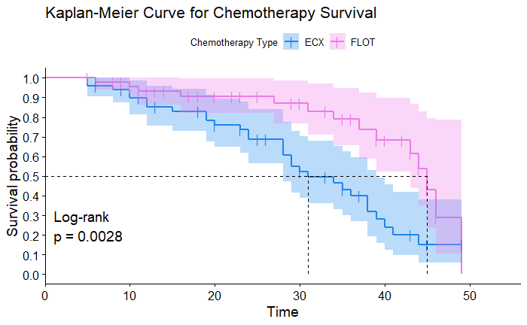
Example of Visuals

Slide 9
Useful Packages in R
To Load Data
readxl() - loading Excel (xls, xlsx) datasets, odbc() - loading data from a database, DBI() - relational database management
To Manipulate Data
tidyverse, dplyr, tidyr - https://www.tidyverse.org/
Visualising data
Ggplot2 - included in the tidyverse package
Modelling data
Tidmodels - https://www.tidymodels.org/ , Caret - https://topepo.github.io/caret/

Slide 10
Hosting Documents - Sharing Code and Version Control
A version control system, or VCS, tracks the history of changes as people and teams collaborate on projects together. As developers make changes to the project, any earlier version of the project can be recovered at any time.
Developers can review project history to find out:
Which changes were made?
Who made the changes?
When were the changes made?
Why were changes needed?
Git Download - https://git-scm.com/downloads
Github - https://github.com/
These resources re hosted on Github for future use, under the various licences you can include https://docs.github.com/en/repositories/managing-your-repositorys-settings-and-features/customizing-your-repository/licensing-a-repository.
Notes:
R:
R is a programming language and environment specifically designed for statistical computing and graphics. It provides a wide variety of statistical and graphical techniques and is highly extensible. R is a free and open-source software that can be downloaded and installed on various operating systems.
RStudio:
RStudio, on the other hand, is an integrated development environment (IDE) for R. It provides a user-friendly interface for working with R, making it easier to write and execute R code. RStudio includes features like a code editor, debugging tools, workspace management, and visualization tools that enhance the R programming experience. RStudio is also free and open-source, with a paid commercial version available that includes additional features for enterprise use.

Slide 11
Some useful resources
Posit / RStudio - https://posit.co/
R For Data Science Online Resource - https://r4ds.hadley.nz/
Tidyverse - https://www.tidyverse.org/
NHS-R Community - https://nhsrcommunity.com/
An Introduction to Statistical Learning: with Applications in R https://www.statlearning.com/
Notes:
R:
R is a programming language and environment specifically designed for statistical computing and graphics. It provides a wide variety of statistical and graphical techniques and is highly extensible. R is a free and open-source software that can be downloaded and installed on various operating systems.
RStudio:
RStudio, on the other hand, is an integrated development environment (IDE) for R. It provides a user-friendly interface for working with R, making it easier to write and execute R code. RStudio includes features like a code editor, debugging tools, workspace management, and visualization tools that enhance the R programming experience. RStudio is also free and open-source, with a paid commercial version available that includes additional features for enterprise use.

Slide 12
Next Course - Intermediate R

